Slide 1
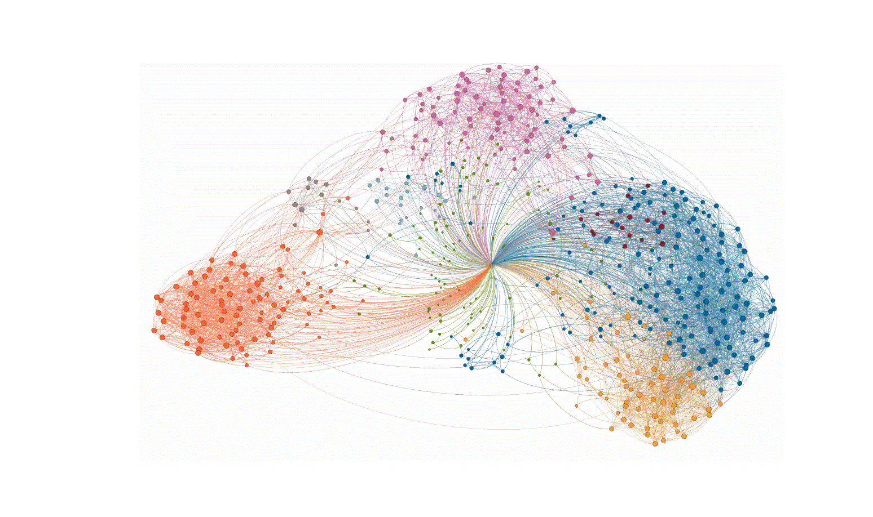
Deep Learning Clustering
Saman Paidar Nia

Slide 2
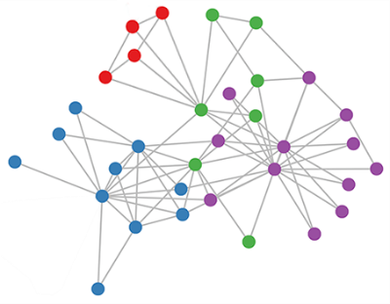
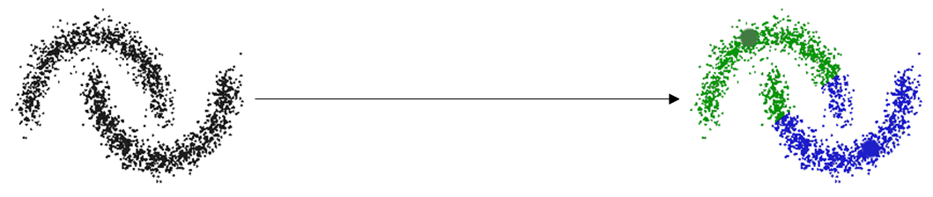
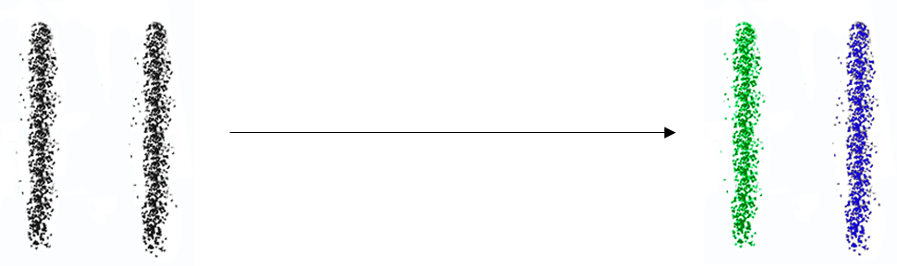
Abstract
K-Means perform stickit for stickit distributed data.
Solution:
Compute the similarity for the graph: G = (V,E).
Optimize and embed the graph similarity to low dimension.
Run the K-Means algorithm on new representation of graph similarity.
Two options for optimization graph similarity:
Spectral embedding
Autoencoder embedding

Slide 3
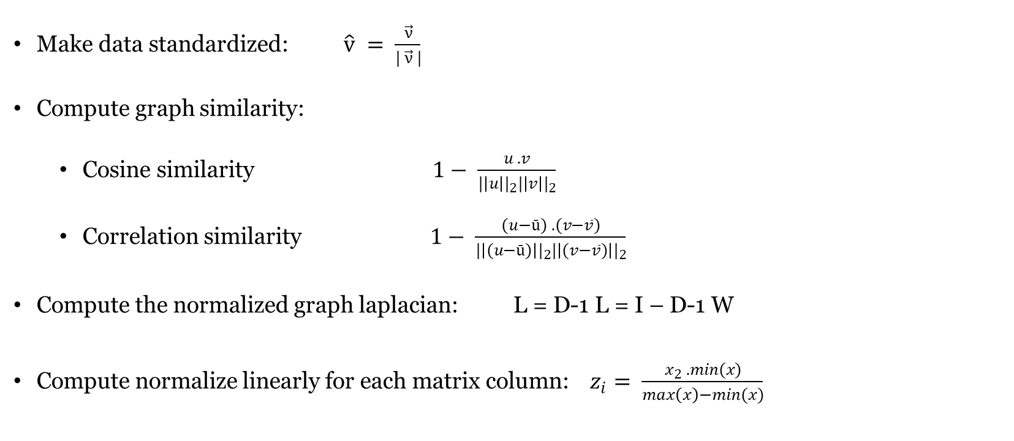
Graph Notion
Make data standardized: $\hat{v} = \frac{\vec{ν}}{| \vec{ν} |}$
Compute graph similarity:
Cosine similarity $1− \frac{u . v}{{|\left|u\right||}_{2}{|\left|v\right||}_{2}}$
Correlation similarity $1− \frac{(u−ū) . (v−\overline{v})}{{|\left|(u−ū)\right||}_{2}{|\left|(v−\overline{v})\right||}_{2}}$
Compute the normalized graph laplacian: L = D-1 L = I – D-1 W
Compute normalize linearly for each matrix column:$z_{i}= \frac{x_{2} . min(x)}{\max\left(x\right)−min(x)}$
Notes:
Where ||*||₂ is the 2-norm of its argument *, and u.v is the dot product of u and v.
Where $\overline{v}$ is the mean of the elements of vector v, and x.y is the dot product of x and y .

Slide 4
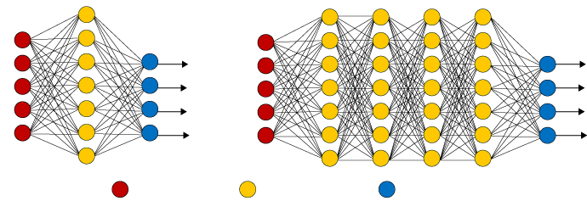
Deep Learning
Deep Learning with massive amounts of computational power, machines can now recognize objects and translate speech in real time.
Simple Neural Network
Deep Learning Neural Network
Input Layer
Hidden Layer
Output Layer
Figure 5 Comparing Simple and Deep Neural Network
by Robert D. Hof, https://www.technologyreview.com/s/513696/deep-learning/

Slide 5
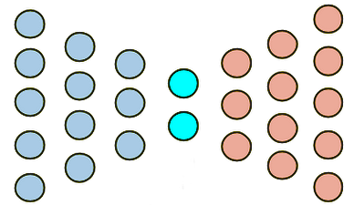
Autoencoder Neural Network
According to UFLDL¹ suppose we have only a set of unlabeled training examples:
{x ⁽¹⁾, x ⁽²⁾,x ⁽³⁾,…} {x ⁽¹⁾, x ⁽²⁾,x ⁽³⁾,…}, where x ^{(i)} ∈ R ^{n}
With applied backpropagation in autoencoder architecture, we can equal the target value with the input value.
y^{(i)} = x^{(i)} -> X ^{(i)} Y ^{(i)}
Figure 6 Autoencoder Architecture
The Deep Learning tutorial , a Stanford tutorial. http://ufldl.stanford.edu/tutorial/unsupervised/Autoencoders/

Slide 6
Stacked Autoencoder Cont.
A autoencoder on the inputs A^{(k)} to learn primary features h^{(1)(k)} on the input.
Using Greedy layer-wise.
Obtaining the feature activations h^{(1)(k)} for each of the inputs A^{(k)}.
Then use these features as the input to another autoencoder.
Input to a Softmax classifier.

Slide 7
Stacked Autoencoder Cont.
Here, we show an example of embedding from five dimensions to two dimension by stacked autoencoder architecture
A₁
Â₁
h₁⁽¹⁾
ĥ₁⁽¹⁾
A₂
h₁⁽¹⁾
Â₂
h₁⁽²⁾
h₂⁽¹⁾
ĥ₂⁽¹⁾
A₃
h₂⁽¹⁾
Â₃
h₂⁽²⁾
h₃⁽¹⁾
ĥ₃⁽¹⁾
A₄
h₃⁽¹⁾
Â₄
+1
+1
A₅
Â₅
Output
+1
Input
Feature 1
Feature 1
+1
Output
Feature 1
Input

Slide 8
Stacked Autoencoder Cont.
Finally, combine all three layers together to form a stacked autoencoder with two hidden layers and a final Softmax classifier layer.
A₁
A₂
h₁⁽¹⁾
h₁⁽²⁾
A₃
h₂⁽¹⁾
h₁⁽¹⁾
P(y=0 | A)
h₂⁽²⁾
A₄
h₃⁽¹⁾
h₂⁽¹⁾
P(y=1 | A)
A₅
+1
+1
Softmax
Classifier
+1
Input
Feature 2
Input
Feature 1
Input

Slide 9
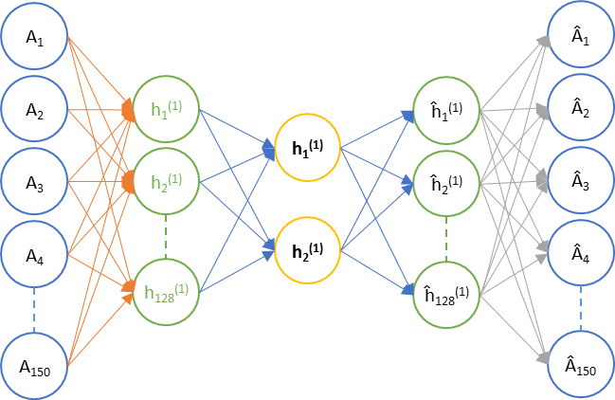
Stacked Autoencoder Cont.
Stacked autoencoder architecture to embed graph similarity to two dimensions for the Iris dataset:

Slide 10
Experimental Evaluation
Using datasets which already have been used by origin and recants papers:
20-newsgroups text dataset
Wine dataset
The structure of our layers is based on origin paper (F. Tian, B. Gao, Q. Cui, E. Chen, T. Liu, 2014) :
Dataset | Nodes
Wine | 178 – 128 – 64
Iris | 150 – 128 – 2
3NG | 600 – 512 – 256
6NG | 1,200 – 1,024 – 512 – 256 - 128
9NG | 1,800 – 1,024 – 512 – 256 - 128

Slide 11
Experimental Evaluation Cont.
Compare the results called AE which shorted for autoencoder to both recent result.
SAE shorted for spars autoencoder for original paper (F. Tian, B. Gao, Q. Cui, E. Chen, T. Liu, 2014).
DAE shorted for denoising autoencoder for second paper (S. Cao, W. Lu, Q, Xu, 2016).
Autoencoder Model | wine | iris | 3NG | 6NG | 9NG
SAE | 84.00 | no-result | 81.00 | 60.00 | 41.00
DAE | no-result | no-result | 80.44 | 68.87 | 59.13
AE | 100 | 100 | 87.83 | 70.09 | 60.64

Slide 12
Experimental Evaluation Cont.
Compare the model with spectral clustering.
To show the power of deep learning also run the k-means algorithm on the original similarity graph.
Clustering Algorithms | wine | iris | 3NG | 6NG | 9NG
K-Means | 87.21 | 100 | 52.95 | 48.10 | 47.35
Spectral Clustering | 86.62 | 100 | 71.14 | 67.27 | 53.94
AE | 100 | 100 | 87.83 | 70.09 | 60.64

Slide 13
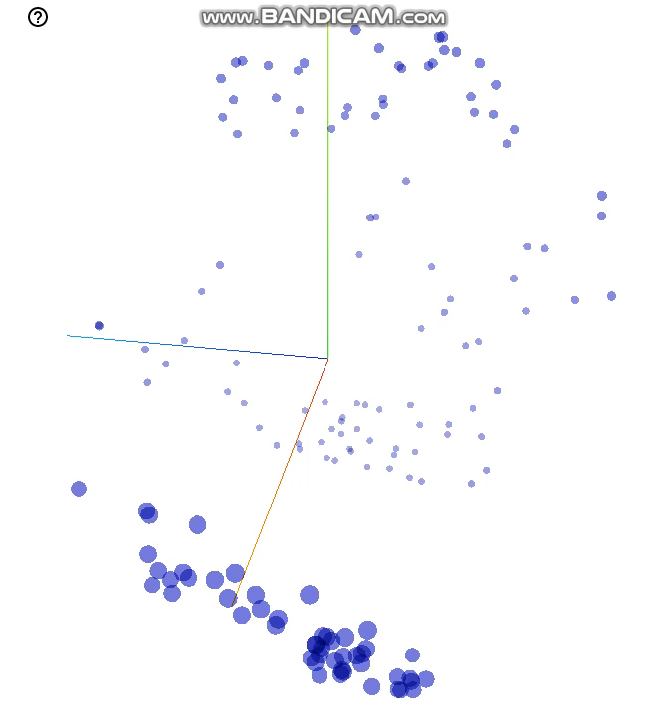
Visualization
Here, we have a similarity matrix (n×n) on Iris dataset.
The dimension is equal with the number of object: 150×150
The dataset is comprise three different groups of Iris flower.
Our similarity can separate all the groups perfectly.

Slide 14
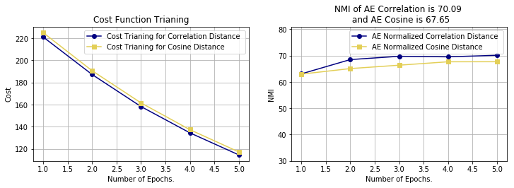
Visualization Cont.
Compute normalized mutual info and cost function after each epoch for 6NG dataset:

Slide 15
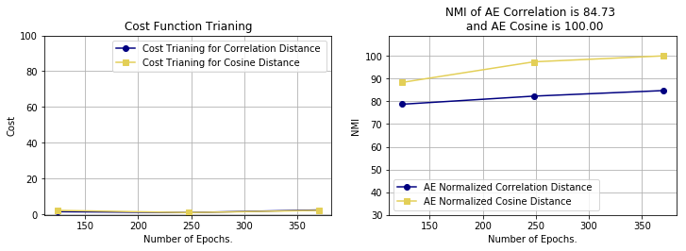
Visualization Cont.
Compute normalized mutual info and cost function after each epoch for wine dataset:

Slide 16
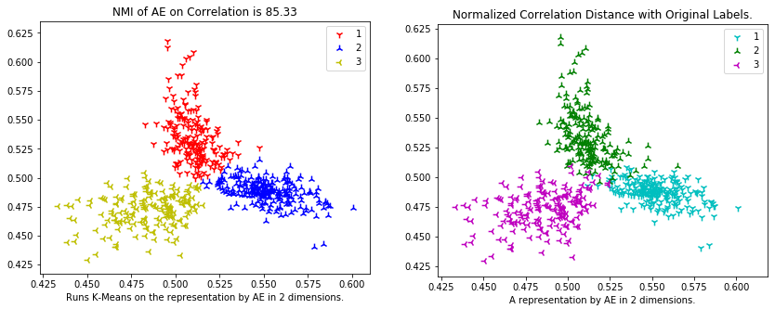
Visualization Cont.
Visualize the Autoencoder implementation on 3NG dataset in two dimensions:

Slide 17
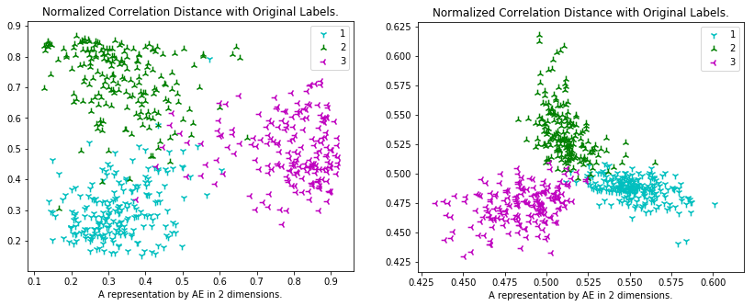
Visualization Cont.
Visualize the Autoencoder implementation on 3NG dataset in two dimensions with deferent Gamma value on batch normalization in activation function (right for 0.1 value and left for 1.0 value) :

Slide 18
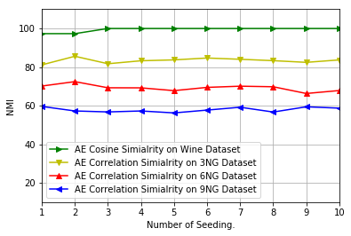
Visualization Cont.
Visualize ten random factors with an average of NMI results:

Slide 19
Questions?

